Slide 1
CS2100
Selected Past Years’ Exam Questions
(Prepared by: Aaron Tan)

Slide 2
Contents:
AY2015/16 Sem1 Exam Q11 (Pipelining)
AY2015/16 Sem1 Exam Q12 (Cache)
AY2016/17 Sem2 Midterm Test Q4 (Boolean Algebra)
AY2016/17 Sem2 Exam Q2
AY2016/17 Sem2 Exam Q6
AY2016/17 Sem2 Exam Q4(a)-(d) (Zephyr)
AY2016/17 Sem2 Exam Q5 (Datapath/control)
AY2017/18 Sem2 Exam Q3 (Combinational circuits)
AY2017/18 Sem2 Exam Q4 (Datapath/control)
AY2017/18 Sem2 Exam Q7 (Cache)
AY2018/19 Sem2 Exam Q5 (Combinational circuits)
AY2018/19 Sem2 Exam Q6 (Cache)
AY2018/19 Sem2 Exam Q7 (Pipelining)

Slide 3
(3-second question.)
What is F?
F = 1
A
B
F
C
D
E

Slide 4
AY2015/16 Semester 1 Q11
addi $t1, $a0, 12 # I1
lw $t0, 12($a0) # I2
Loop: lw $t2, -4($t1) # I3
sw $t2, 0($t1) # I4
addi $t1, $t1, -4 # I5
bne $t1, $a0, Loop # I6
sw $t0, 0($t1) # I7
$a0 stores the base addr of integer array A. What does the code do?
Rotates A[0], A[1], A[2], A[3] one element to the right.
A[0]
A[1]
A[2]
A[3]
(b) If first instruction executed is I1, which is the seventh instruction executed?
Instruction I3.

Slide 5
AY2015/16 Semester 1 Q11
addi $t1, $a0, 12 # I1
lw $t0, 12($a0) # I2
Loop: lw $t2, -4($t1) # I3
sw $t2, 0($t1) # I4
addi $t1, $t1, -4 # I5
bne $t1, $a0, Loop # I6
sw $t0, 0($t1) # I7
(c) No data forwarding. Branch resolved at stage 4.
Total number of cycles:
3+(3×11)+5 = 41
 | 1 | 2 | 3 | 4 | 5 | 6 | 7 | 8 | 9 | 10 | 11 | 12 | 13 | 14 | 15 | 16 | 17 | 18 | 19 | 20 | 21
I1 | F | D | E | M | W
I2 |  | F | D | E | M | W
I3 |  |  | F | - | D | E | M | W
I4 |  |  |  | F | - | - | - | D | E | M | W
I5 |  |  |  |  | F | - | - | - | D | E | M | W
I6 |  |  |  |  |  | F | - | - | - | - | - | D | E | M | W
I3 |  |  |  |  |  |  |  |  |  |  |  |  |  |  | F | D | E | M | W

Slide 6
AY2015/16 Semester 1 Q11
addi $t1, $a0, 12 # I1
lw $t0, 12($a0) # I2
Loop: lw $t2, -4($t1) # I3
sw $t2, 0($t1) # I4
addi $t1, $t1, -4 # I5
bne $t1, $a0, Loop # I6
sw $t0, 0($t1) # I7
(d) With data forwarding. Branch resolved at stage 2, predicted taken.
Total number of cycles = 23
 | 1 | 2 | 3 | 4 | 5 | 6 | 7 | 8 | 9 | 10 | 11 | 12 | 13 | 14 | 15 | 16 | 17 | 18 | 19 | 20 | 21
I1 | F | D | E | M | W
I2 |  | F | D | E | M | W
I3 |  |  | F | D | E | M | W
I4 |  |  |  | F | D | E | M | W
I5 |  |  |  |  | F | D | E | M | W
I6 |  |  |  |  |  | F | - | D | E | M | W
I3 |  |  |  |  |  |  | F | - | D | E | M | W

Slide 7
AY2015/16 Semester 1 Q12
int sum = 0;
for (int i=0; i<32; i++) {
sum = sum + (A[i] * B[i]) – C[i];
}
Direct-mapped cache, 8 blocks. Each block 4 words.
(a) What is the cache hit rate of the code?
Addresses:
A: 0x00000080; B: 0xFFFF0040; C: 0x12345688
0x00000080 = … 0000 00001 000 0000
0xFFFF0040 = … 0000 00000 100 0000
0x12345688 = … 0101 01101 000 1000
First four iterations:
A[0]..A[3] mapped to block 0.
B[0]..B[3] mapped to block 4.
C[0], C[1] mapped to block 0,
C[2], C[3] mapped to block 1.
A[0] (miss), A[1] (miss), A[2] (miss), A[3] (hit).
B[0] (miss), B[1]..B[3] (hits)
C[0] (miss), C[1] (miss), C[2] (miss), C[3] (hit).
Hit rate = 5/12

Slide 8
AY2015/16 Semester 1 Q12
int sum = 0;
for (int i=0; i<32; i++) {
sum = sum + (A[i] * B[i]) – C[i];
}
(b) Fill in the content of the cache after executing the code.
A: … 0000 00001 000 0000
B: … 0000 00000 100 0000
C: … 0101 01101 000 1000
Block 0 | C[30] | C[31] | unknown | unknown
Block 1 | B[20] | B[21] | B[22] | B[23]
Block 2 | B[24] | B[25] | B[26] | B[27]
Block 3 | B[28] | B[29] | B[30] | B[31]
Block 4 | A[16] | A[17] | A[18] | A[19]
Block 5 | A[20] | A[21] | A[22] | A[23]
Block 6 | A[24] | A[25] | A[26] | A[27]
Block 7 | A[28] | A[29] | A[30] | A[31]
First four iterations:
A[0]..A[3] mapped to block 0.
B[0]..B[3] mapped to block 4.
C[0], C[1] mapped to block 0,
C[2], C[3] mapped to block 1.

Slide 9

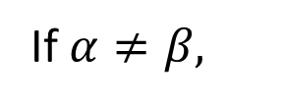

AY2016/17 Semester 2 Midterm Q4
Simplify the following expression of a 15-variable Boolean function.
m’s are the minterms and M’s the maxterms.
(m3125 ⋅ M987 ⋅ m1025) + m895 ⋅ (M2222 + M618)
0
1
Answer: m895
If $α≠β,$
$$mα∙mβ=0$$
$$Mα+Mβ=1$$

Slide 10
AY2016/17 Semester 2 Exam Q2
A | B | C | D | A | C | B | D | F=(AC<BD)
0 | 0 | 0 | 0 | 0 | 0 | 0 | 0 | 0
0 | 0 | 0 | 1 | 0 | 0 | 0 | 1 | 1
0 | 0 | 1 | 0 | 0 | 1 | 0 | 0 | 0
0 | 0 | 1 | 1 | 0 | 1 | 0 | 1 | 0
0 | 1 | 0 | 0 | 0 | 0 | 1 | 0 | 1
0 | 1 | 0 | 1 | 0 | 0 | 1 | 1 | 1
0 | 1 | 1 | 0 | 0 | 1 | 1 | 0 | 1
0 | 1 | 1 | 1 | 0 | 1 | 1 | 1 | 1
1 | 0 | 0 | 0 | 1 | 0 | 0 | 0 | 0
1 | 0 | 0 | 1 | 1 | 0 | 0 | 1 | 0
1 | 0 | 1 | 0 | 1 | 1 | 0 | 0 | 0
1 | 0 | 1 | 1 | 1 | 1 | 0 | 1 | 0
1 | 1 | 0 | 0 | 1 | 0 | 1 | 0 | 0
1 | 1 | 0 | 1 | 1 | 0 | 1 | 1 | 1
1 | 1 | 1 | 0 | 1 | 1 | 1 | 0 | 0
1 | 1 | 1 | 1 | 1 | 1 | 1 | 1 | 0
(a) F(A,B,C,D) = Σm(1,4,5,6,7,13 )
Implement using a 2-bit magnitude comparator with no logic gates.
2-bit
COMP
A
C
1
0
X
X<Y
X=Y
X>Y
F
B
D
1
0
Y

Slide 11
AY2016/17 Semester 2 Exam Q2
(b) G(A,B,C,D) = Σm(2,11 )
Implement using a 2×4 decoder and one XOR gate.
(A ⊕ D)'
Σm(2,11 ) = A'⋅B'⋅C⋅D' + A⋅B'⋅C⋅D = C⋅((A'⋅D' + A⋅D) ⋅B’)
2×4
DEC
0
1
2
3
G
A ⊕ D
B
S₁
S₀
EN
C

Slide 12
AY2016/17 Semester 2 Exam Q6
Cache access time = 5ns, main memory access time = 80ns.
(a) What is the memory access time when you have a cache hit?
5 ns
(b) What is the memory access time when you have a cache miss?
80 + 5 = 85 ns
(c) 10,000 accesses take 70 μs. What is the cache miss rate?
70 μs = 70,000 ns.
Average miss access time = 70,000/10,000 = 7 ns.
Average miss access time = miss_rate * 80 + 5
7 = miss_rate * 80 + 5
miss_rate = 2/80 = 2.5%

Slide 13
AY2016/17 Semester 2 Exam Q6
4-way set associative write-back cache.
Total 64KB. Each block = 8 words. Each word = 4 bytes. 32-bit addresses.
(d) How many bits per set do you require to store the tags?
32 bytes per block → byte offset = 5 bits.
Each set → 32 words = 128 bytes. #sets = 64KB/128 = 512 → set index = 9 bits.
Tag = 32 – 5 – 9 = 18 bits.
Therefore, #tag bits per set = 18×4 = 72 bits.

Slide 14
AY2016/17 Semester 2 Exam Q6
4-way set associative write-back cache.
Total 64KB. Each block = 8 words. Each word = 4 bytes. 32-bit addresses.
(e) What is the total amount of static RAM required to implement this cache?
Each block has 18 tag bits, 1 valid bit and 1 dirty bit → 20 bits.
In total, 512 (sets) × 4 (blocks/set) × 20 = 40,960 bits = 5120 bytes = 5 KB.
Therefore, 64KB + 5KB = 69KB.

Slide 15
AY2016/17 Semester 2 Q4
(a) Using the instruction set given, write the Zephyr assembly language equivalent of this program. Ensure that your code is properly commented.
for (i=0; i<5; i++)
if (x[i]<3)
x[i] = x[i]+5;
LDI $1, 0 ; Initialize index i to 0
LDI $2, 5 ; Loop limit of 5
LDI $3, x ; Base address of array x
LDI $4, 3 ; Our compare value
Label: LW $5, $3 ; Load array element
BGT $5, $4, Out ; Exit if bigger than 3
BEQ $5, $4, Out ; Exit if equal to 3
PUSH $5 ; Add 5 to array elt
PUSHI 5 ;
ADD ;
POP $5 ; Get result
SW $5, $3 ; Store it back to array
Out: INCW $3 ; Increment base by 4
INC $1 ; Increment index by 1
BLT $1, $2, Label ; Repeat if < 5
LDI $y, c: Load Immediate c into register y.
LW $y, $x: Load Word at address in $x into register y.
SW $y, $x: Store Word in register y into address in register x.
BEQ/BGT/BLT $x, $y, disp: Branch if register x equal/greater than/less than y.
INC/DEC $y: Increment/decrement register y by 1.
INCW/DECW $y: Increment/decrement register y by 4.

Slide 16
AY2016/17 Semester 2 Q4
(b) Sketch the instruction formats for all 6 classes, assuming that all 32 bits of a Zephyr instruction word are utilized fully, and that we maximize the number of opcode bits.
A: 32-bit operand
B: 29-bit operand, 3-bit register
C: 16-bit operand, 16-bit constant
D: 13-bit operand, 3-bit register, 16-bit constant
E: 26-bit operand, 3-bit register 1, 3-bit register 2
F: 10-bit operand, 3-bit register 1, 3-bit register 2, 16-bit displacement.

Slide 17
AY2016/17 Semester 2 Q4
(c) If we utilize an expanding opcode scheme for Zephyr, what is the maximum number of opcodes possible, assuming that there are at least one instruction in each class?
We want to maximize the number of Class A instructions but must leave one special opcode each for the remaining classes.
For these special opcodes, the remaining opcode bits cannot be used as they are part of “something else”, e.g. register numbers.
So # of unusable bits for each opcode class is:
B: (32 – 29) = 3 bits
C: (32 – 16) = 16 bits
D: (32 – 13) = 19 bits
E: (32 – 26) = 6 bits
F: (32 – 10) = 22 bits
So, total number of opcodes is: 2³² – 2³ – 2¹⁶ – 2¹⁹ – 2⁶ – 2²² + 5
The +5 is the one instruction each in the remaining 5 classes.

Slide 18
AY2016/17 Semester 2 Q4
(d) What is the minimum number of opcodes possible, assuming that there are at least one instruction in each class?
We maximize the most restrictive case but leave opcodes for the remaining 5 classes.
In this case Class F is the most restrictive class since it has only 10 opcode bits. We reserve 5 opcodes for the remaining classes.
So # of opcodes = 2¹⁰ – 5 + 5 = 2¹⁰ = 1024 opcodes.

Slide 19
AY2016/17 Semester 2 Q5
To support 2 new instructions: BLT (Branch on Less Than) and BGT (Branch on Greater Than).
BLT:
0x08
rs
rt
displacement
BGT:
0x12
rs
rt
displacement
The ALU is shown below. Show, by adding AT MOST ONE 32-input logic gate and any additional wires, how to generate the IsZero and IsNegative signals.
IsZero signal is 1 when ALUIn1 – ALUIn2 = 0
IsNegative signal is 1 when ALUIn1 – AluIn2 < 0.
32
ALUIn1
32
ALUOut
IsZero
32
ALUIn2
ALUControl
ALUOut[31]
IsNegative
4

Slide 20
AY2016/17 Semester 2 Q5
(b) The CONTROL unit in the datapath must now generate BranchLess and BranchGreater signals from the instruction bits. Sketch the combinational circuits to generate these signals.
BLT: 0x08 = 00 1000
BGT: 0x12 = 01 0010
Inst
Inst
[31]
[31]
[30]
[30]
[29]
BranchLess
[29]
BranchGreater
[28]
[28]
[27]
[27]
[26]
[26]
[25]
[25]
:
:
[0]
[0]

Slide 21
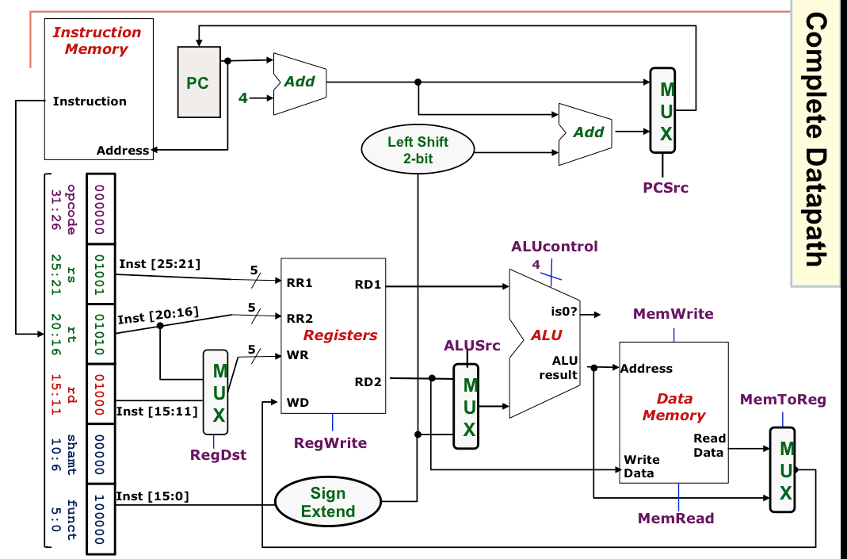
AY2016/17 Semester 2 Q5
(c) Sketch the combinational circuit needed to generate the PCSrc control signal to support the BEQ, BLT and BGT instructions.
IsZero
BEQ
Branch
GreaterThan
BGT
IsNegative
BranchGreater
BLT
BranchLess
PCSrc

Slide 22
AY2020/21 Semster 2
CS2100 Exam
Date: 27 April 2021, Tuesday
Time: 5-7pm (set aside 4 – 7:30pm)
Format
Q0: 3 marks
Part A: 6 MCQs (12 marks)
Part B: 5 MRQs (15 marks)
Part C: 5 long questions (70 marks)
3-page answer sheets provided (optional)
Submit a single pdf file

Slide 23
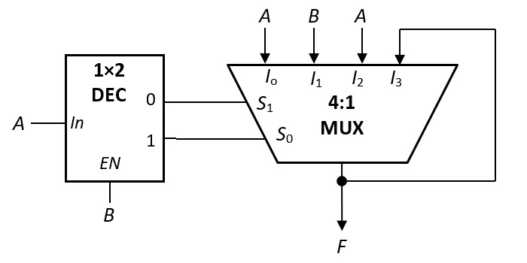
AY2017/18 Semester 2 Q3
(a) Given the following circuit, what is F?
A | B | F
0 | 0
0 | 1
1 | 0
1 | 1
0
0
1
1
F = A

Slide 24






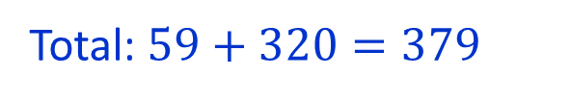
AY2017/18 Semester 2 Q4
(a) Suppose MIPS instructions in R-format must use the following 5 opcodes (in decimal): 0, 1, 16, 17 and 32, what is the maximum total number of instructions that can be supported in MIPS?
Answer: 379
6-bit
6-bit
opcode
funct
Non-R-format:
$${(2}^{6}−5)$$
$$=59$$
R-format:
$$5$$
$$×$$
$$2^{6}$$
$$=320$$
Total: $59+320=379$

Slide 25
AY2017/18 Semester 2 Q4
(b) Suppose due to a hardware defect in the datapath circuit, a stuck-at-0 fault occurs at bit 6 of every MIPS instruction. This means that bit 6 of a MIPS instruction is always 0 regardless of what the instruction is originally. Devise a simple test using a MIPS instruction to discover this error. Explain your test.
One possible test: addi $t0, $zero, 64
0
0 0 0 0 0 0 0 0 0 1 0 0 0 0 0 0
This is supposed to put 64 into $t0.
However, due to stuck-at-0 fault in bit 6, the final value in $t0 will be 0.
Other appropriate examples are accepted.

Slide 26
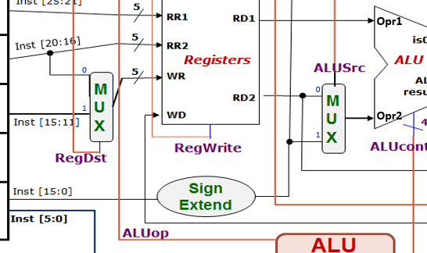
AY2017/18 Semester 2 Q4
(c) Suppose the stuck-at-0 fault occurs at the ALUSrc control signal.
Assuming that $t0 and $t1 contain 12 and 34 respectively, and we are to use the instruction lw $t1, 0($t0) to discover the error. Describe what other preparation work needs to be done. You may assume that we can write data into any location in the memory.
Note that ALUSrc chooses between RD2 and SignExt(Inst[15:0]).
12
If the instruction is correctly carried out, lw $t1, 0($t0) would have loaded the value at memory address 12 into $t1.
34
With stuck-at-0 fault at ALUSrc, the instruction would have loaded the value at memory address 46 into $t1 instead.
0
Hence, we could first load different values in addresses 12 and 46 before using the test.

Slide 27
AY2017/18 Semester 2 Q4
(d) You want to add the bne instruction into the datapath, which already includes the required hardware for the instruction. Write out the ALUop for bne and how you can determine whether the bne results in the branch to be taken.
Opcode | ALUop
lw | 00
sw | 00
beq | 01
R-type | 10
: | :
Since ALUop code 11 is not used, we may use it for bne.
Hence, branch taken = ALUop1 AND ALUop2 AND !(isZero) where (isZero) is the output from the ALU.
or
Use ALUop code 01 (same as beq).
Hence, branch taken = !ALUop1 AND ALUop2 AND !(isZero) where (isZero) is the output from the ALU, or
branch taken = Branch AND !(isZero) .

Slide 28
AY2017/18 Semester 2 Q7
$s0: base addr. of array A;
$s1: base addr. of array B.
$s2: n, #elements in array A (and B)
beq $s2, $zero, End # Inst1, Addr: 0x0040003c
addi $t8, $s2, -1 # Inst2
sll $t8, $t8, 2 # Inst3
Loop: add $t0, $s0, $t8 # Inst4
add $t1, $s1, $t8 # Inst5
lw $t2, 0($t0) # Inst6
lw $t3, 0($t1) # Inst7
andi $t4, $t3, 3 # Inst8
addi $t4, $t4, -3 # Inst9
beq $t4, $zero, A1 # Inst10
add $t2, $t2, $t3 # Inst11
j A2 # Inst12
A1: addi $t2, $t2, 1 # Inst13
A2: sw $t2, 0($t0) # Inst14
addi $t8, $t8, -8 # Inst15
slt $t7, $t8, $zero # Inst16
beq $t7, $zero, Loop # Inst17
End:
int i;
for (i=n-1; i>=0; i-=2) {
if (B[i]%4 == 3)
A[i]++;
else
A[i] += B[i];
}

Slide 29
AY2017/18 Semester 2 Q7
Assuming that arrays A and B now each contains 1024 positive integers. Given a direct-mapped data cache with 128 words in total, each block containing 4 words with each word being 4 bytes long, arrays A and B are stored starting at memory addresses 0x10001000 and 0x1003F100 respectively.
The data cache is involved when memory is accessed (i.e., when lw and sw are executed.)
(a) How many bits are there in the index field? In the byte offset field?
Number of blocks = 128/4 = 32 = $2^{5}$ → index field: 5 bits
Number of bytes per block = 16 = $2^{4}$ → byte offset field: 4 bits
(b) Which index is A[1023] mapped to? Which index is B[1023] mapped to?
A[0] at 0x10001000 → A[1024] at 0x10002000 → A[1023] at 0x10001FFC
10001FFC → … 1111 1111 1100 → Index 31
B[0] at 0x1003F100 → B[1024] at 0x10040100 → B[1023] at 0x100400FC
100400FC → … 0000 1111 1100 → Index 15

Slide 30
AY2017/18 Semester 2 Q7
(c) How many memory accesses in total are made for array A? For array B?
int i;
for (i=n-1; i>=0; i-=2) {
if (B[i]%4 == 3)
A[i]++;
else
A[i] += B[i];
}
512 elements for each array are accessed:
[1023], [1021], …, [3], [1].
A: 1024 accesses (1 read and 1 write per element);
B: 512 accesses.
(d) What is the cache hit rate for array A? For array B?
Since A[1023] and B[1023] are mapped to different indices, there will not be any cache thrashing.
Index
A: 256 misses, 768 hits, hit rate = 75%.
B: 256 misses, 256 hits, hit rate = 50%.
15
B[1020]
B[1021]
B[1022]
B[1023]
31
A[1020]
A[1021]
A[1022]
A[1023]

Slide 31
AY2017/18 Semester 2 Q7
(e) Given a direct-mapped instruction cache with 16 words in total, each block containing 2 instructions (words), and the first beq instruction is at memory address 0x0040003c. How many cache hits and misses are there in total during the execution of the code, assuming that the beq instruction at Inst10 always branches to A1? You may consider only the instructions in the given code segment, i.e., Inst1 – Inst17.
Total #instructions = 3 + 512×12 = 6147.
Index
Cache index field: 3 bits; byte offset: 3 bits.
0
I2
I3
First instruction at 0x0040003c →
… 0011 1100 → index 7, word 1 (second word)
1
I4
I5
2
I6
I7
3
I8
I9
Cache content in first iteration:
Misses: I1, I2, I4, I6, I8, I10, I13, I14 and I16.
4
I10
Subsequently, all instructions are in the cache.
5
I13
Therefore, 9 misses, 6138 hits.
6
I14
I15
7
I16
I1
I17

Slide 32
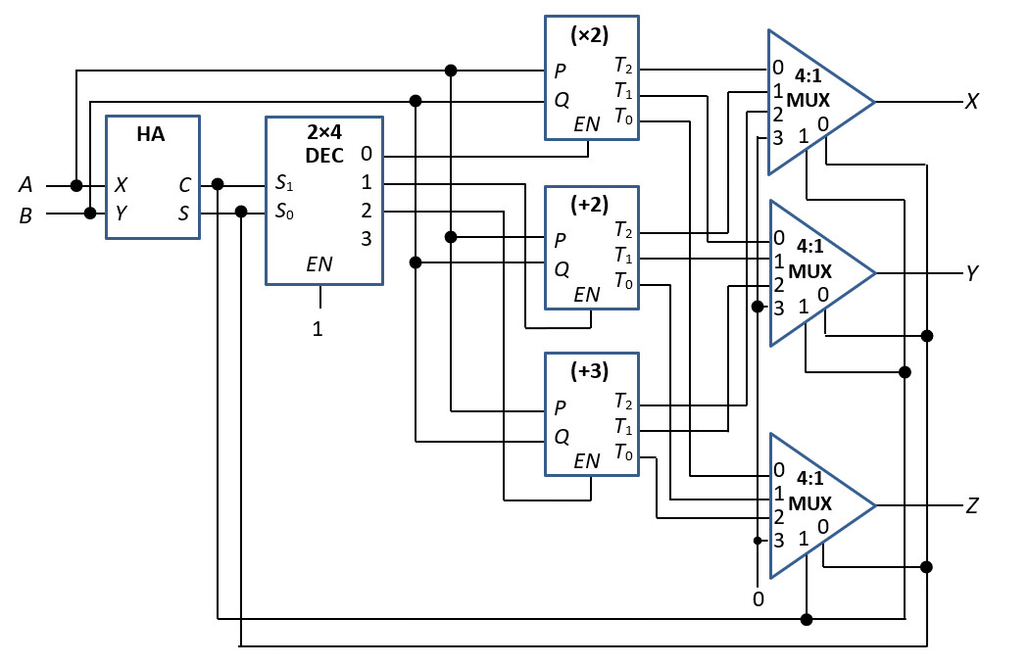
AY2018/19 Semester 2 Q5
(e) A (×2)-device: takes in two inputs P and Q and produces 3-bit output with value (P+Q) ×2.
A (+2)-device: takes in two inputs P and Q and produces 3-bit output with value P+Q+2.
A (+3)-device: takes in two inputs P and Q and produces 3-bit output with value P+Q+3.
A | B | C | S | X | Y | Z
0 | 0 | 0 | 0 | 0 | 0 | 0
0 | 1 | 0 | 1 | 0 | 1 | 1
1 | 0 | 0 | 1 | 0 | 1 | 1
1 | 1 | 1 | 0 | 1 | 0 | 1
X = A⋅B
Y = A⊕B
Z = A+B

Slide 33
AY2018/19 Semester 2 Q6
add $t0, $s0, $0 # Inst1, Address: 0x00FFFF18
add $t1, $s1, $0 # Inst2
add $t2, $s2, $0 # Inst3
add $t3, $s3, $s3 # Inst4: $t3 = 2n
add $t4, $0, $0 # Inst5: $t4 = k (loop variable)
Loop: slt $t5, $t4, $t3 # Inst6: k < 2n?
beq $t5, $0, End # Inst7
lw $t6, 0($t0) # Inst8
lw $t7, 0($t1) # Inst9
add $t6, $t6, $t7 # Inst10
sw $t6, 0($t0) # Inst11
lw $t8, 4($t0) # Inst12
lw $t9, 0($t2) # Inst13
add $t8, $t8, $t9 # Inst14
sw $t8, 4($t0) # Inst15
addi $t0, $t0, 8 # Inst16
addi $t1, $t1, 4 # Inst17
addi $t2, $t2, 4 # Inst18
addi $t4, $t4, 2 # Inst19
j Loop # Inst20
End:
Arrays B and C each contains n elements;
Array A contains 2n elements.
A[k] = A[k] + B[k/2] if k is even
A[k] = A[k] + C[(k-1)/2] if k is odd
$s0, $s1, $s2 = base addr. of A,B,C (resp.)
$s3 = n, size of array B

Slide 34
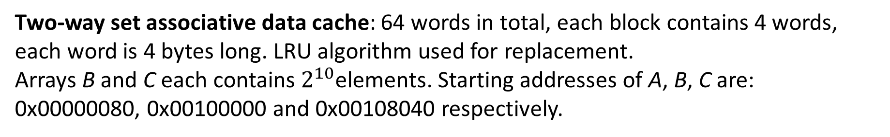
AY2018/19 Semester 2 Q6
Two-way set associative data cache: 64 words in total, each block contains 4 words, each word is 4 bytes long. LRU algorithm used for replacement.
Arrays B and C each contains $2^{10}$elements. Starting addresses of A, B, C are:
0x00000080, 0x00100000 and 0x00108040 respectively.
(a) How many bits are there in the set index field? In the byte offset field?
#blocks = 64/4 = 16.
2 blocks per set → 8 sets → set index: 3 bits
4 words/block → 16 bytes/block → byte offset: 4 bits
(b) Which set is A[0]/B[60]/C[1032] mapped to?
A[0] at 0x00000080 → 00… 0000 1000 0000 → set 0
B[0] at 0x00100000 → B[60] at 0x001000F0 (60×4=240 = 0xF0) →
00… 0000 1111 0000 → set 7
C[0] at 0x00108040 → C[1032] at 0x00109060 (1032×4=4128 = 0x1020) →
00… 0000 0110 0000 → set 6

Slide 35
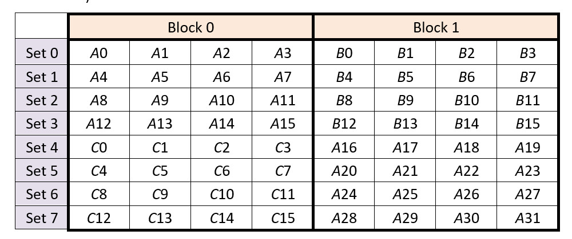
AY2018/19 Semester 2 Q6
(c) What is the cache hit rate for array A? For array B? For array C?
A[0] at set 0; B[0] at set 0; C[0] at set 4.
Cache content for the first 16 iterations. (Array element A[k] is shown as Ak.)
Hit rate for A: 7/8
Hit rate for B: 3/4
Hit rate for C: 3/4

Slide 36
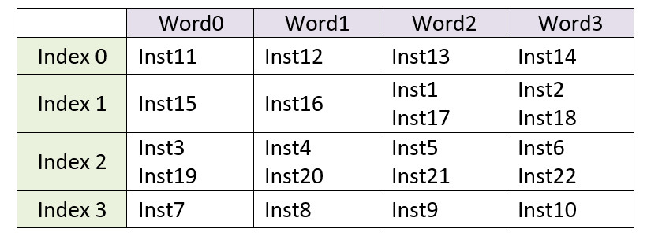
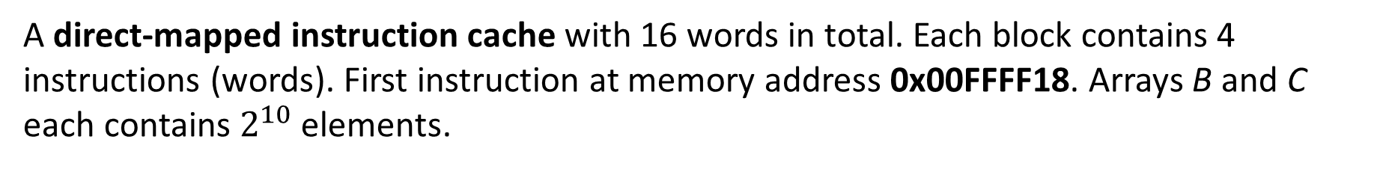
AY2018/19 Semester 2 Q6
A direct-mapped instruction cache with 16 words in total. Each block contains 4 instructions (words). First instruction at memory address 0x00FFFF18. Arrays B and C each contains $2^{10}$ elements.
(d) How many misses are there in the first iteration (Inst1 – Inst20)?
#blocks = 16/4 = 4 → index: 2 bits.
#bytes/block = 16 → byte offset: 4 bits.
Addr. of 1st inst = 0x00FFFF18 → … 0001 1000 → index 1, word 2.
Content of cache in first iteration:
Misses: 1, 3, 7, 11, 15, 19
→ 6 misses.

Slide 37
AY2018/19 Semester 2 Q6
(e) How many misses are there in the second iteration (Inst6 – Inst20)?
Misses: 6, 19
→ 2 misses.

Slide 38

AY2018/19 Semester 2 Q6
(f) How many misses are there in the execution of the whole code?
There are $2^{10}=1024$ iterations.
First iterations: 6 misses.
Second through 1024th iterations: $1023×2=2046$ misses.
1 last miss due to Inst6.
Total = 6 +2046+1 = 2053 misses.

Slide 39
AY2018/19 Semester 2 Q7
# $s0 = base address of array A
# $s1 = base address of array B
# $s2 = base address of array C
# $s3 = n, the number of elements in array B
add $t0, $s0, $0 # Inst1, Address: 0x00FFFF18
add $t1, $s1, $0 # Inst2
add $t2, $s2, $0 # Inst3
add $t3, $s3, $s3 # Inst4: $t3 = 2n
add $t4, $0, $0 # Inst5: $t4 = k (loop variable)
Loop: slt $t5, $t4, $t3 # Inst6: k < 2n?
beq $t5, $0, End # Inst7
lw $t6, 0($t0) # Inst8
lw $t7, 0($t1) # Inst9
add $t6, $t6, $t7 # Inst10
sw $t6, 0($t0) # Inst11
lw $t8, 4($t0) # Inst12
lw $t9, 0($t2) # Inst13
add $t8, $t8, $t9 # Inst14
sw $t8, 4($t0) # Inst15
addi $t0, $t0, 8 # Inst16
addi $t1, $t1, 4 # Inst17
addi $t2, $t2, 4 # Inst18
addi $t4, $t4, 2 # Inst19
j Loop # Inst20
End:
(a) The jump (j) instruction causes a control hazard. What is the minimum number of stall cycles that a jump instruction would incur and how can that be achieved?
The jump instruction incurs one stall cycle, if computation of the next PC value is done at ID stage.

Slide 40
AY2018/19 Semester 2 Q7
(b) Without forwarding and branch decision is made at MEM stage. No branch prediction, no delay branching. How many cycles does the code (Inst1 – Inst19) take?
add $t0, $s0, $0 # Inst1, Address: 0x00FFFF18
add $t1, $s1, $0 # Inst2
add $t2, $s2, $0 # Inst3
add $t3, $s3, $s3 # Inst4: $t3 = 2n
add $t4, $0, $0 # Inst5: $t4 = k (loop variable)
Loop: slt $t5, $t4, $t3 # Inst6: k < 2n?
beq $t5, $0, End # Inst7
lw $t6, 0($t0) # Inst8
lw $t7, 0($t1) # Inst9
add $t6, $t6, $t7 # Inst10
sw $t6, 0($t0) # Inst11
lw $t8, 4($t0) # Inst12
lw $t9, 0($t2) # Inst13
add $t8, $t8, $t9 # Inst14
sw $t8, 4($t0) # Inst15
addi $t0, $t0, 8 # Inst16
addi $t1, $t1, 4 # Inst17
addi $t2, $t2, 4 # Inst18
addi $t4, $t4, 2 # Inst19
j Loop # Inst20
End:
38 cycles
Ideal pipeline: 19 + 4 = 23 cycles
… D E M W
… D E …
I6: 2 cycles of delay
beq: … D E M W
F …
I7: 2 cycles of delay
I8: 3 cycles of delay
I10: 2 cycles of delay
I11: 2 cycles of delay
I14: 2 cycles of delay
I15: 2 cycles of delay
Total delay: 15 cycles
Total cycles: 23 + 15 = 38

Slide 41
AY2018/19 Semester 2 Q7
(c) With forwarding and early branching (decision at ID stage). No branch prediction, no delay branching. How many cycles does the code (Inst1 – Inst19) take?
add $t0, $s0, $0 # Inst1, Address: 0x00FFFF18
add $t1, $s1, $0 # Inst2
add $t2, $s2, $0 # Inst3
add $t3, $s3, $s3 # Inst4: $t3 = 2n
add $t4, $0, $0 # Inst5: $t4 = k (loop variable)
Loop: slt $t5, $t4, $t3 # Inst6: k < 2n?
beq $t5, $0, End # Inst7
lw $t6, 0($t0) # Inst8
lw $t7, 0($t1) # Inst9
add $t6, $t6, $t7 # Inst10
sw $t6, 0($t0) # Inst11
lw $t8, 4($t0) # Inst12
lw $t9, 0($t2) # Inst13
add $t8, $t8, $t9 # Inst14
sw $t8, 4($t0) # Inst15
addi $t0, $t0, 8 # Inst16
addi $t1, $t1, 4 # Inst17
addi $t2, $t2, 4 # Inst18
addi $t4, $t4, 2 # Inst19
j Loop # Inst20
End:
27 cycles
Ideal pipeline: 19 + 4 = 23 cycles
slt: F D E M W
beq: F X D E M W
I7: 1 cycle of delay
beq: … D E M W
F …
I8: 1 cycle of delay
lw: F D E M W
add: F D X E …
I10: 1 cycle of delay
I14: 1 cycle of delay
Total delay: 4 cycles
Total cycles: 23 + 4 = 27

Slide 42
AY2018/19 Semester 2 Q7
(d) With forwarding and early branching (decision at ID stage). Branch prediction, predicted not taken. How many cycles does the code (Inst1 – Inst19) take?
add $t0, $s0, $0 # Inst1, Address: 0x00FFFF18
add $t1, $s1, $0 # Inst2
add $t2, $s2, $0 # Inst3
add $t3, $s3, $s3 # Inst4: $t3 = 2n
add $t4, $0, $0 # Inst5: $t4 = k (loop variable)
Loop: slt $t5, $t4, $t3 # Inst6: k < 2n?
beq $t5, $0, End # Inst7
lw $t6, 0($t0) # Inst8
lw $t7, 0($t1) # Inst9
add $t6, $t6, $t7 # Inst10
sw $t6, 0($t0) # Inst11
lw $t8, 4($t0) # Inst12
lw $t9, 0($t2) # Inst13
add $t8, $t8, $t9 # Inst14
sw $t8, 4($t0) # Inst15
addi $t0, $t0, 8 # Inst16
addi $t1, $t1, 4 # Inst17
addi $t2, $t2, 4 # Inst18
addi $t4, $t4, 2 # Inst19
j Loop # Inst20
End:
26 cycles
Ideal pipeline: 19 + 4 = 23 cycles
slt: F D E M W
beq: F X D E M W
I7: 1 cycle of delay
beq: … D E M W
F …
I8: 1 cycle of delay
lw: F D E M W
add: F D X E …
I10: 1 cycle of delay
I14: 1 cycle of delay
Total delay: 3 cycles
Total cycles: 23 + 3 = 26

Slide 43
AY2018/19 Semester 2 Q7
(e) With forwarding. How would you rearrange the instructions to reduce the number of stall cycles, and how many stall cycles is reduced as a result of this?
add $t0, $s0, $0 # Inst1, Address: 0x00FFFF18
add $t1, $s1, $0 # Inst2
add $t2, $s2, $0 # Inst3
add $t3, $s3, $s3 # Inst4: $t3 = 2n
add $t4, $0, $0 # Inst5: $t4 = k (loop variable)
Loop: slt $t5, $t4, $t3 # Inst6: k < 2n?
beq $t5, $0, End # Inst7
lw $t6, 0($t0) # Inst8
lw $t7, 0($t1) # Inst9
add $t6, $t6, $t7 # Inst10
sw $t6, 0($t0) # Inst11
lw $t8, 4($t0) # Inst12
lw $t9, 0($t2) # Inst13
add $t8, $t8, $t9 # Inst14
sw $t8, 4($t0) # Inst15
addi $t0, $t0, 8 # Inst16
addi $t1, $t1, 4 # Inst17
addi $t2, $t2, 4 # Inst18
addi $t4, $t4, 2 # Inst19
j Loop # Inst20
End:
More than one possible answers.
Move I10 and I11 to after I13, reducing 2 stall cycles.

Slide 44
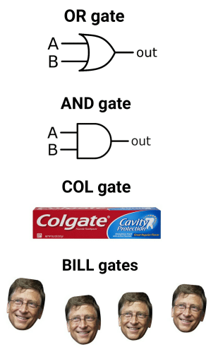

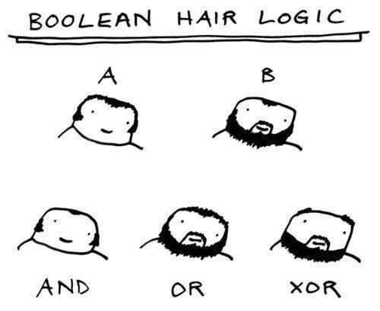


Slide 45
END OF FILE

